Slide 1
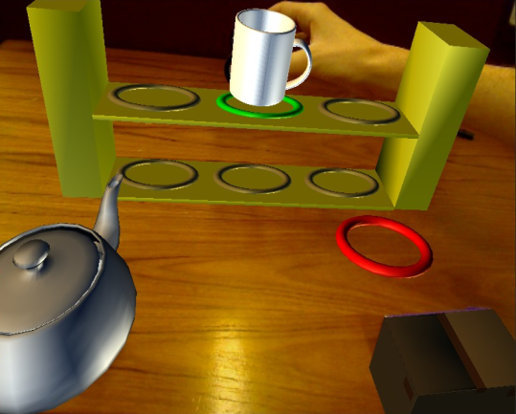
Games For Upper-limb Stroke Rehabilitation James Burke Michael McNeill Philip Morrow Darryl Charles School of Computing and Information Engineering Suzanne McDonough Jacqui Crosbie School of Life and Health Sciences
School of Computing & Information Engineering

Slide 2
Research Overview
The Problem Area:
Stroke is a leading cause of severe physical disability.¹
Difficult to provide optimal therapy for patient’s needs.
Difficult to maintain patient motivation.²
Upper limb remains weak in up to 66% cases.³
The Proposed Solution:
Technology has been applied to stroke rehabilitation in many studies.⁴
Video games may be effective in optimising engagement & motivation.
British Heart Foundation & Stroke Association (2009) Stroke Statistics. http://tinyurl.com/stroke09
Burdea (2002) "Key note address: Virtual rehabilitation – benefits and challenges."
Van der Lee et al. (1999) “Forced use of the upper extremity in chronic stroke patients”.
Crosbie et al. (2007) "Virtual Reality in Stroke Rehabilitation: Still More Virtual Than Real".

Slide 3
Game Design for Stroke Rehab
Video games are well known as a means of providing excitement, stimulation, motivation, challenge and enjoyment.
“Designers of rehabilitation tasks can benefit from examining the formulas that commercial game developers use…” ¹
Three important principles selected for rehabilitation:
Meaningful Play
Appropriate level of challenge
Handling Failure
Rizzo & Kim (2005) “A SWOT analysis of the field of virtual reality rehabilitation and therapy”.

Slide 4
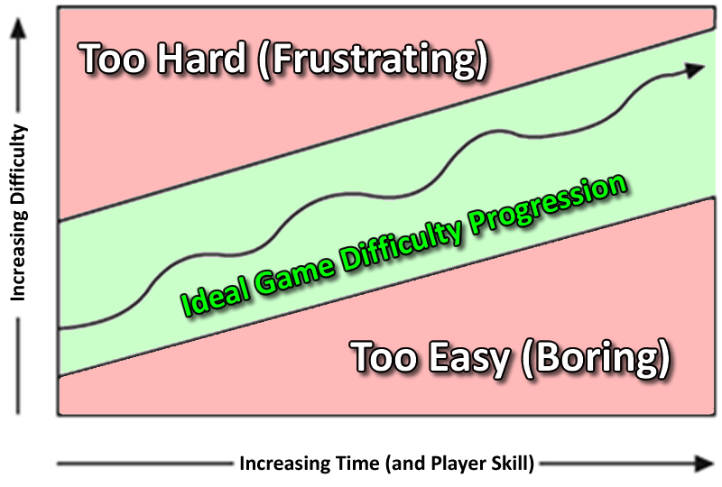
Game Design Principles
Meaningful Play
Inputs choices
Player
Game
Meaningful play
Feedback
Discernable and integrated outcome & Goals
1,2
Maintaining Challenge Appropriately
Match patient abilities.
How to maintain challenge?
How to handle failure?
Csikszentmihalyi (1988) “Optimal Experience: Psychological Studies of Flow in Consciousness”.
Rabin (2005) “Introduction to Game Development”.

Slide 5
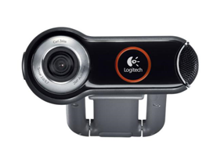
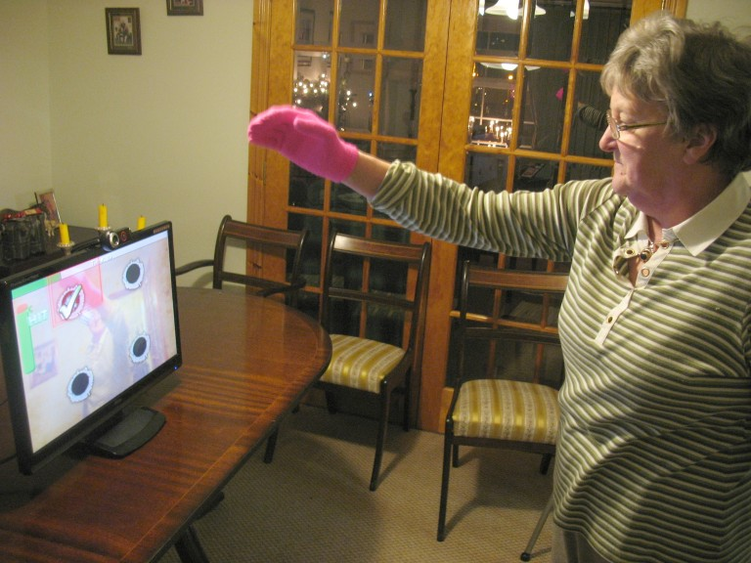
Webcam Games
Low cost game system.
Contains multiple games which share a stored player profile.
Single and bimanual arm rehabilitation.
Tracks a coloured glove or mitt with any standard webcam - intuitive controls.
Play standing or seated.
Dynamic level of challenge.
Clear and consistent user interface.
No attaching of wires required.
Potential for home rehabilitation.

Slide 6
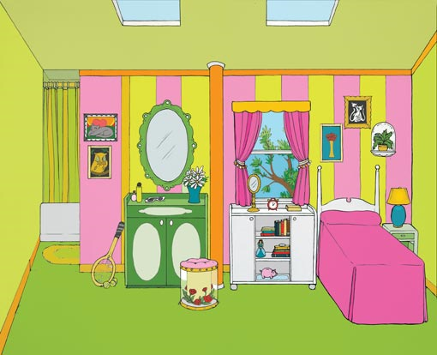
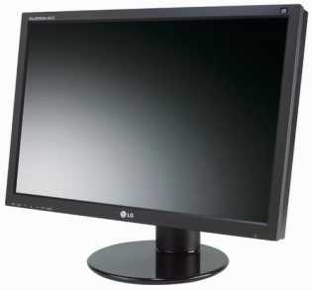
Webcam Games
L
R
Player Movement Wearing Gloves
Image Captured by USB Webcam
Image Processed – Pixels identified for each glove
Output to Monitor / Projector

Slide 7
Webcam Games Video
View at: http://www.youtube.com/watch?v=1_QH1a0AziA

Slide 8
Evaluation of Webcam Games
Initial phase – Evaluation with able-bodied users.
Phase 2 – Single play evaluation with stroke users:
Three participants recruited with varying degrees of movement.
Played each game a number of times and filled out questionnaire on usability (including playability).
All participants were able to play well, displayed enthusiasm and enjoyed the games.
Some expressed interest in obtaining the games for home use.
Phase 3 – Three week single user case studies.

Slide 9
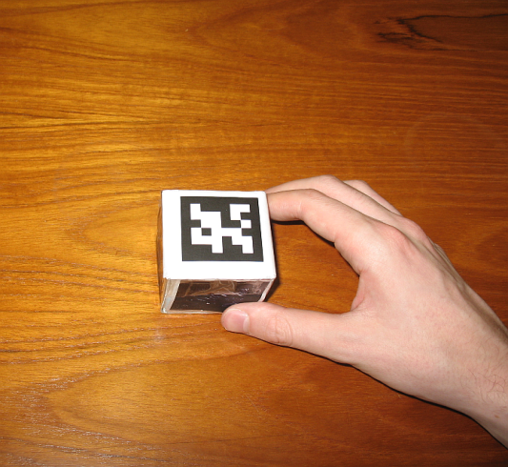
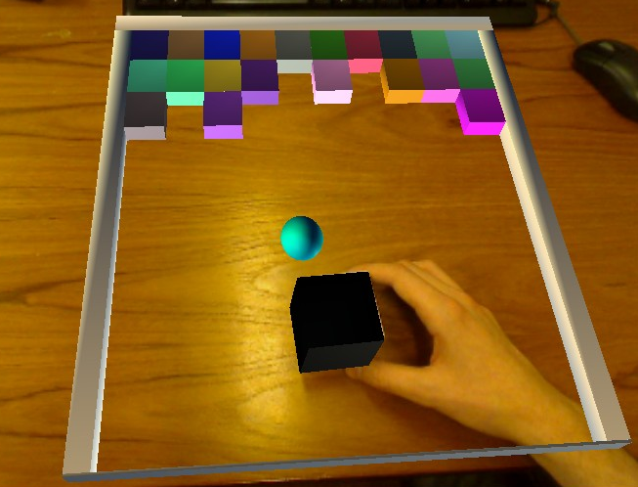
Augmented Reality Games
Marker-Based AR.
Markers tracked via image from standard webcam.
Real-world image augmented with virtual elements.
Allows use of physical objects of varying size, shape and weight.
Rehabilitate high quality motor skills which are more transferable to activities of daily living?

Slide 10
Augmented Reality Prototype Games Video
View at: http://www.youtube.com/watch?v=clSGq8C0JyM

Slide 11
Final Remarks
Ongoing & Future Work:
Develop the games further.
Overcome issues (camera placement, dealing better with occlusion, depth perception aids).
Evaluation of games with able-bodied users and people with stroke.
Conclusion:
Games have potential to engage and motivate during rehabilitation.
Low-cost off-the-shelf hardware may offer an opportunity for home rehabilitation in addition to traditional therapy.
Augmented reality offers opportunity for rehabilitation of meaningful skills.

Slide 12
Questions?
Michael McNeill
mdj.mcneill@ulster.ac.uk
James Burke
burke-j5@email.ulster.ac.uk
Darryl Charles
dk.charles@ulster.ac.uk

