Slide 1



AmbiLearn: an ambient intelligent multimodal learning environment for children
Jennifer Hyndman
Supervisors: Dr. Tom Lunney, Prof. Paul Mc Kevitt
Intelligent Systems Research Centre (ISRC)
University of Ulster, Magee

Slide 2
Introduction
Learning environment constantly changing
  m-learning/e-learning/virtual learning environments
Emphasis on personalised learning
  games/virtual reality/augmented reality
C2k project – LearningNI (available but not adopted fully)
Why?
  lack of material available (Ofsted, 2009)
  Limited multimodality
  Limited interactivity

Slide 3
Aims & Objectives
  Redress the limited use of virtual learning environments in primary school education
  Multimodality and interactivity – enhance learning environment
    Utilising speech – natural interaction
    Utilising game technology – improve learning
    Addressing children needs – system design
    Facilitate collaborative learning
Development of AmbiLearn
  Address interface design - children
  Address usability – children
  Demonstrate educational potential
    Games in education
    Multimodal learning environments

Slide 4
Background
Virtual learning environments
  Enhancing the learning experience through technology
Games as the learning environment
  Motivating, engaging children
Multimodal Interfaces
  Progressing towards natural communication methods
Child computer interaction
  Greater emphasis on designing systems to address children's needs

Slide 5
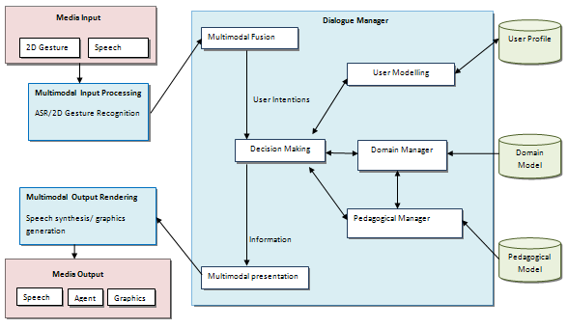
AmbiLearn

Slide 6
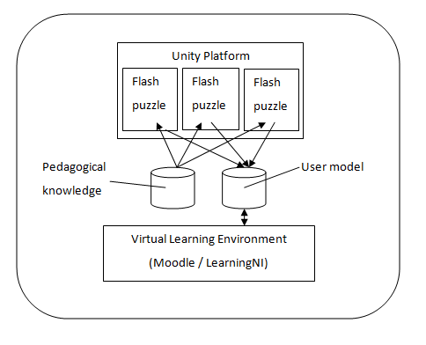
Software architecture

Slide 7
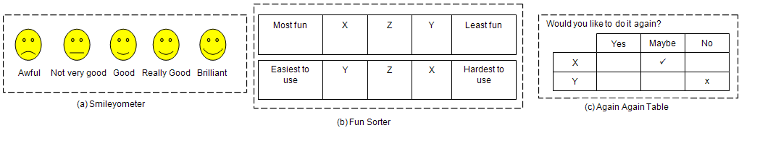
Testing / Evaluation
Quantitative & Qualitative results
  Pre test/post test
  Questionnaires
Evaluating with children
  Fun toolkit (Read and MacFarlane, 2006)

Slide 8
Conclusion
Address interface design and usability issues
Facilitate a child's ubiquitous learning environment
Demonstrate and test the educational potential AmbiLearn
  Multimodality
  Games
  Positive effect on education

Slide 9
Publications
Hyndman, J., Lunney, T. and Mc Kevitt, P. (2009) “AmbiLearn: ambient intelligent multimodal learning environment for children”, In Proc. of the 10th Annual PostGraduate Symposium on The Convergence of Telecommunications, Networking and Broadcasting (PGNET-09), Liverpool John Moores University, Liverpool, England, June 22nd-23rd, 277-282.
Hyndman, J., Lunney, T. and Mc Kevitt, P. (2011) “AmbiLearn – Multimodal Assisted Learning”, International Journal of Ambient Computing and Intelligence. In Press.

Slide 10
Thank You!

