Slide 1
Personal Assistants on Smartphones – Re-Inventing the Wheel?
Michael McTear
Computer Science Research Institute
University of Ulster
International Workshop on “Waiting for Artificial Intelligence...: Desperately seeking The Loebner Prize'‘, 15th September, 2013, University of Ulster Magee Campus, Legenderry

Slide 2
Overview
Overview of Virtual Personal Assistants
Natural Language Processing for Virtual Personal Assistants
Virtual Personal Assistants: Issues and New Developments
Is this AI?

Slide 3
Overview of Virtual Personal Assistants

Slide 4
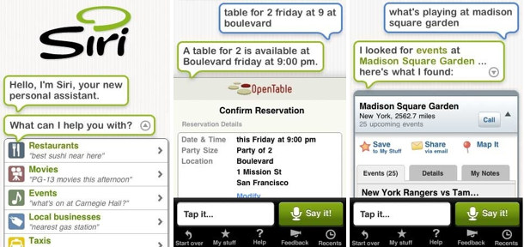

Slide 5
Android apps
Alice
CallMom
Skyvi
Cluzee
Jeannie
Eva
Evi
Iris
Edwin
Google Voice Search
Speaktoit Assistant
Vlingo Personal Assistant
Maluuba
…

Slide 6
VPAs: What can they do?
Services and apps on the phone:
Email, text messaging, social networking, calendar and map functions, …
Voice search
Factual question answering
Q: Is a hormone deficiency associated with Kallman’s syndrome?”
A: Yes. A deficiency of GnRH is associated with Kallman’s syndrome” (with source evidence listed)

Slide 7
Spoken dialogue systems
AI-based approaches
BDI architectures
Plan recognition, discourse relations, plan generation, beliefs and intentions, dialogue control, …
Statistical approaches
Reinforcement learning
Dialogue optimisation, belief models, learning from experience, ….
Corpus / example based
Decisions about dialogue control based on previous interactions

Slide 8
Voice User Interfaces
Voice-enabled information and services
Flight times, stock quotes, weather, bank services, utilities, …
VoiceXML
Dialogue scripting
Form-filling applications
System driven dialogue initiative
Integrated with web services

Slide 9
Chatbots
ELIZA, PARRY, ALICE, …
Loebner prize
Used in education, information retrieval, business, e-commerce, and in automated help desks.
Based on pattern matching
But becoming more sophisticated with representations of dialogue history, background knowledge, anaphoric reference, …

Slide 10
Embodied Conversational Agents
Computer-generated animated characters that combine facial expression, body stance, hand gestures, and speech to provide an enriched channel of communication
Used in applications such as interactive language learning, virtual training environments, virtual reality game shows, and interactive fiction and storytelling systems.
Increasingly used in eCommerce and eBanking to provide friendly and helpful automated help

Slide 11
Reasons for the recent emergence of VPAs
The availability of cloud-based services for smartphone users that provide high quality speech recognition (and natural language processing).
Tight integration of the apps with services and apps available on the smartphone.
Access to information and services on the web.

Slide 12
Architecture / main elements
Service delegation - APIs
Mapped to domain and task models
E.g. book meal, route information, weather, etc.
Mapped to language and dialogue
Conversational interface
Deals with meaning and intent
Context: location, time, task, dialogue
Personal context awareness
Different for different users, knows your personal information e.g. where you are (e.g. book a flight to London), also time and calendar information

Slide 13
Natural Language Processing for Virtual Personal Assistants

Slide 14
Natural Language Processing
“Arguably, the most important ingredient of this new perspective is the accurate inference of user intent and correct resolution of any ambiguity in associated attributes.”
“While speech input and output modules clearly influence the outcome by introducing uncertainty into the observed word sequence, the correct delineation of the task and thus its successful completion heavily hinges on the appropriate semantic interpretation of this sequence.“
Source: J.R.Bellegarde, Natural Language Technology in Mobile Devices: Two Grounding Frameworks.
In: A. Neustein and J.A. Markowitz (eds.), Mobile Speech and Advanced Natural Language Solutions, Springer Science+Business Media, New York 2013

Slide 15
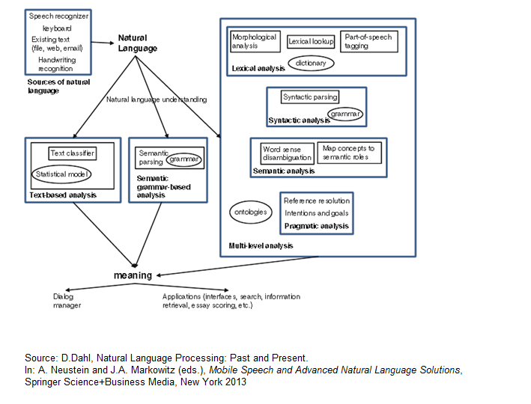
Approaches to NLP

Slide 16
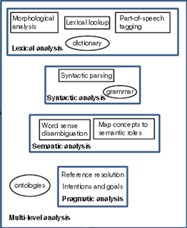

Slide 18
Which approach is best?
Semantic grammar
Works well for limited domain applications (e.g. VUIs, where input is predictable)
Text classification
Good for broad classification (e.g. troubleshooting where input is unpredictable)
Multi-level analysis
Good for detailed analysis of the input (e.g. multi-domain question-answering)

Slide 19
Virtual Personal Assistants: Issues and New Developments

Slide 20
Future trends
How to distribute initiative effectively
Current apps usually involve “one-shot” queries
Maintaining dialogue history
Cannot handle follow-up queries
Google Conversational search
Recovering gracefully from misrecognitions and misunderstandings

Slide 21
Dialogue Example (Siri): No dialogue history
User: Where can I have lunch?
Siri: (gets current location) I found 14 restaurants whose reviews mention lunch. 12 of them are fairly close to you.
User: How about downtown?
Siri: I don’t know what you mean by ‘how about downtown’
User: I want to have lunch downtown
Siri: I found 3 restaurants matching downtown …

Slide 22
Dealing with Misrecognitions
Q: When was Britney Spears born?
“Britney Spears was born on Wednesday December 2nd 1981”
“Let’s check Google” Written output: Best guess for Britney Spears – Date of Birth is December 2, 1981
“December 2nd 1981 and December 1981”
Searches Wolfram Alpha, returns table with rows for: full name, date of birth, place of birth
“Hey – let’s keep this professional”
Notes:
When was Britney Spears born?
Evi – Britney Spears was born on Wednesday December 2nd 1981
Speaktoit Assistant – Let’s check Google: Written Best guess for Britney Spears – Date of Birth is December 2, 1981
If ‘porn’ recognised, ‘Hey – let’s keep this professional’
Dwin – recognised ‘porn’ searhes Wiolfram Alpha, returnd table: full name: Britney Spears / date of birth: … / place of birth: ***
Vlingo – returnd list of urls
Jeannie – recog ‘porn’ searches True Knowledge returns sp[eech December 2nd 1981 and December 1981
Iris – you asked when was BS porn - recently

Slide 23
Recognition Result
When was Britney Spears porn?
“Hey – let’s keep this professional”
Recognised ‘porn’ but went on to search Wolfram Alpha and returned result for ‘born’
“You asked when was Britney Spears porn - recently”

Slide 24
Enterprise VPAs
VPAs for specialist domains, travel, finance, and healthcare
Online customer care
Customers should be able to explain their enquiry in their own words
The answer should be the precise answer they’re looking for, not a list of urls.

Slide 25
Prodigy (Nuance)
Natural input and output, so that the customer can interact with the technology in their natural language.
Extraction of the meaning and the intent
Additional questions asked in a conversational way to clarify any ambiguity or obtain additional information.
Find and return the best answer and offers the customer the chance to ask more questions about that answer in a conversational manner.

Slide 26
IBM Watson (Memorial Sloan-Kettering Cancer Center)
Methods for handling ‘big data’ and making it useful e.g. decision support tool for doctors
Input: Query describing symptoms
Watson:
Parses input for key items of information
Mines patient data for relevant information
Combines this information with findings from tests
Examines data sources (incorporate treatment guidelines, electronic medical record data, doctor's and nurse's notes, research, clinical studies, journal articles, and patient information) to form and test hypotheses
Provides list of potential diagnoses along with a score that indicates the level of confidence for each hypothesis.
NLP, data mining, hypothesis generation, evidence-based learning

Slide 27
Is this AI?

Slide 28
Source: V. Sejnoha, Expanding Voice as a Mainstream Mobile Interface through Language Understanding. Mobile Voice 2012.

