Slide 1
The Imitation Game in Games
Distinguishing NPC from Human Player
Prof. Minhua Eunice Ma
Professor of Computer Games Technology
Digital Design Studio, Glasgow School of Art
University of Glasgow

Slide 2
Outline
Background: about DDS
Conversation-based vs. game-based Turing test
Loebner Prize vs. BotPrize
Turing test in board games (chess)
Turing test in video games (UT2004)
Player modelling and mimic player types
The goal of game AI
When the goals merge, a reversed Turing test in SpyParty

Slide 3
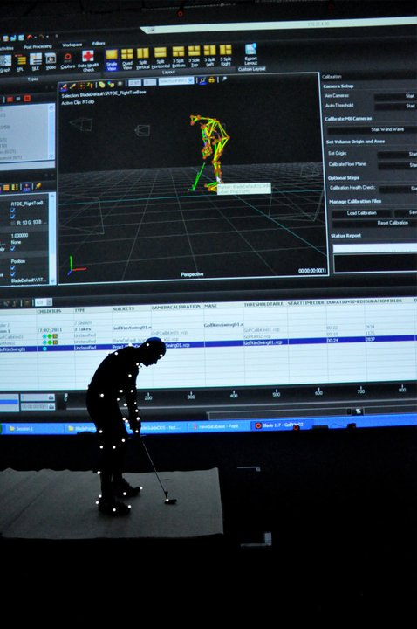
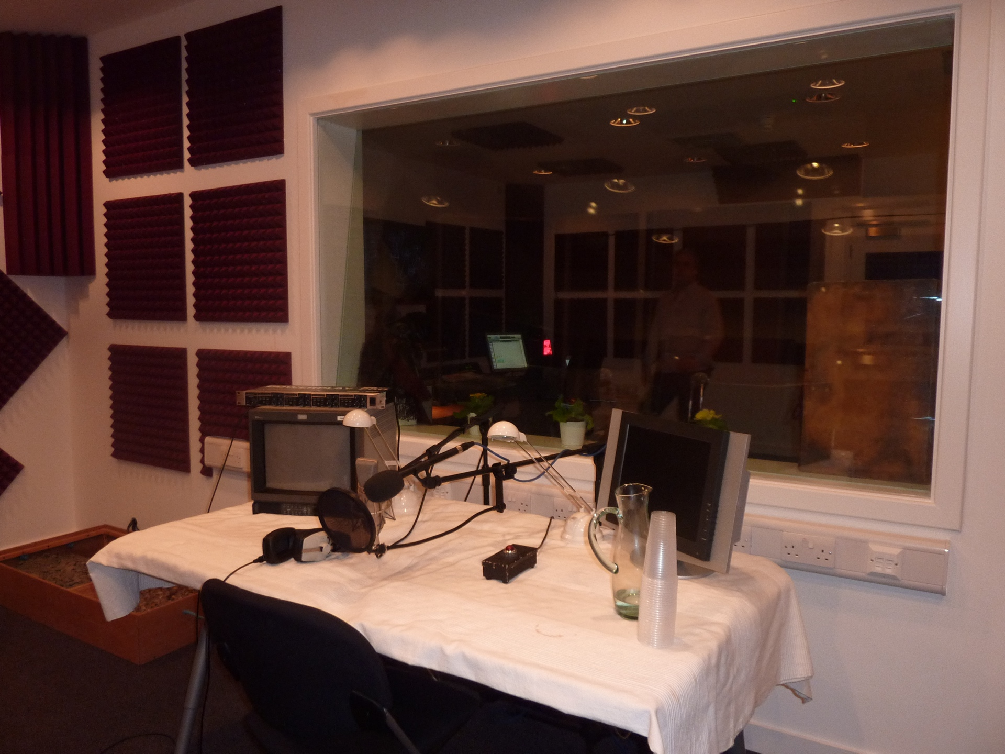
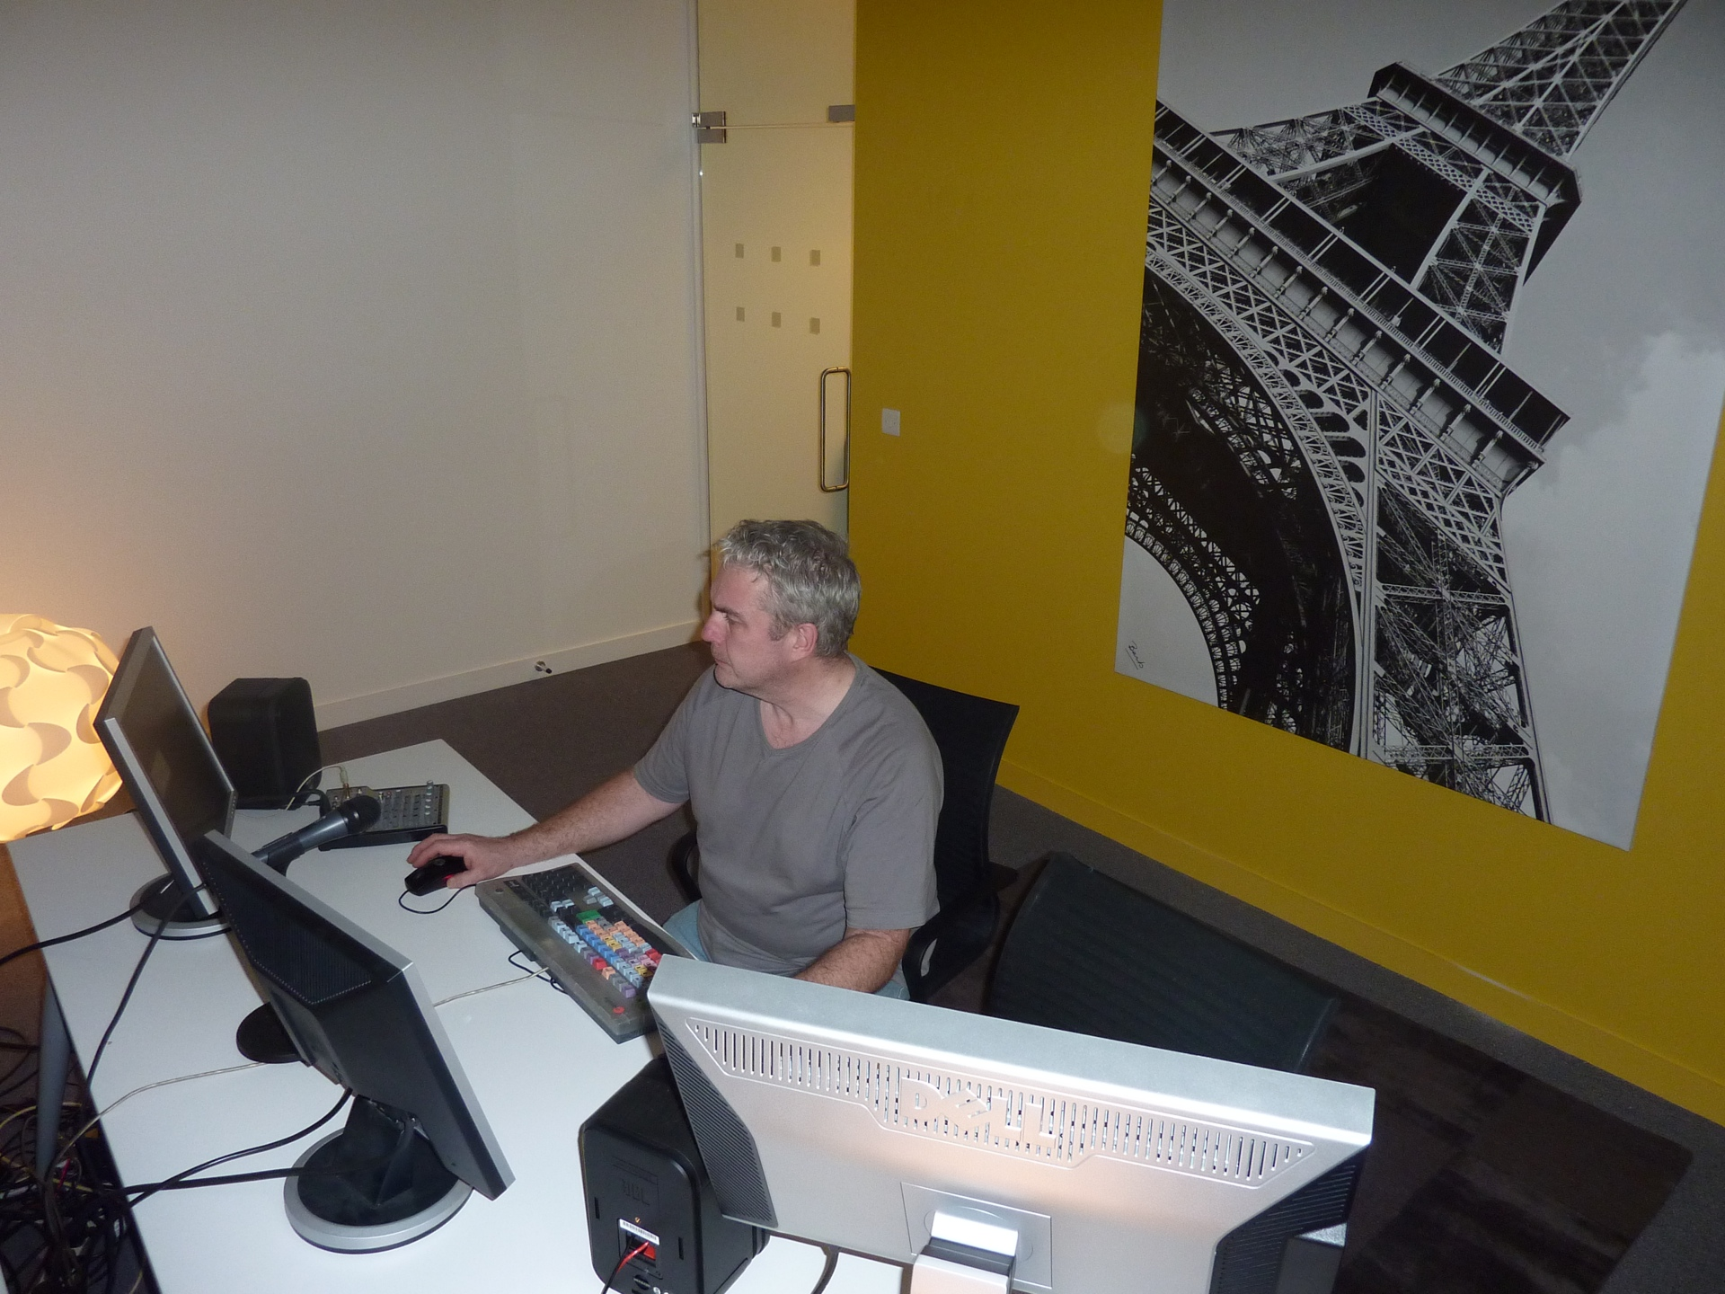
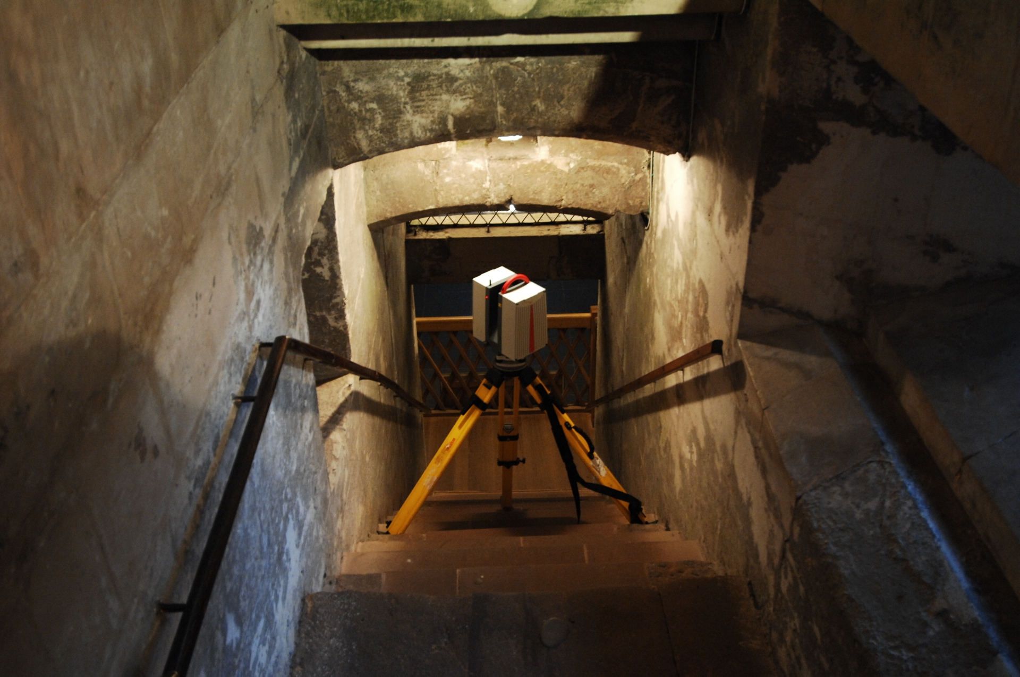
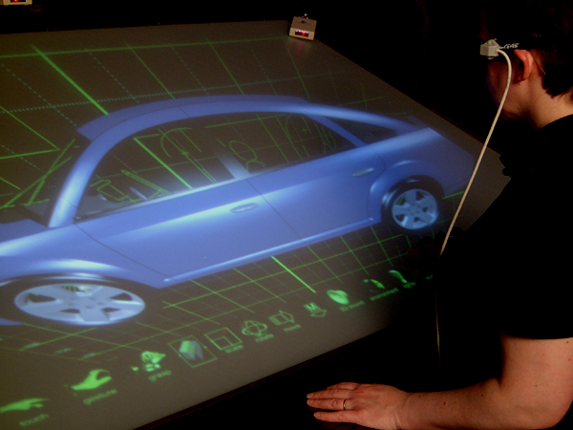
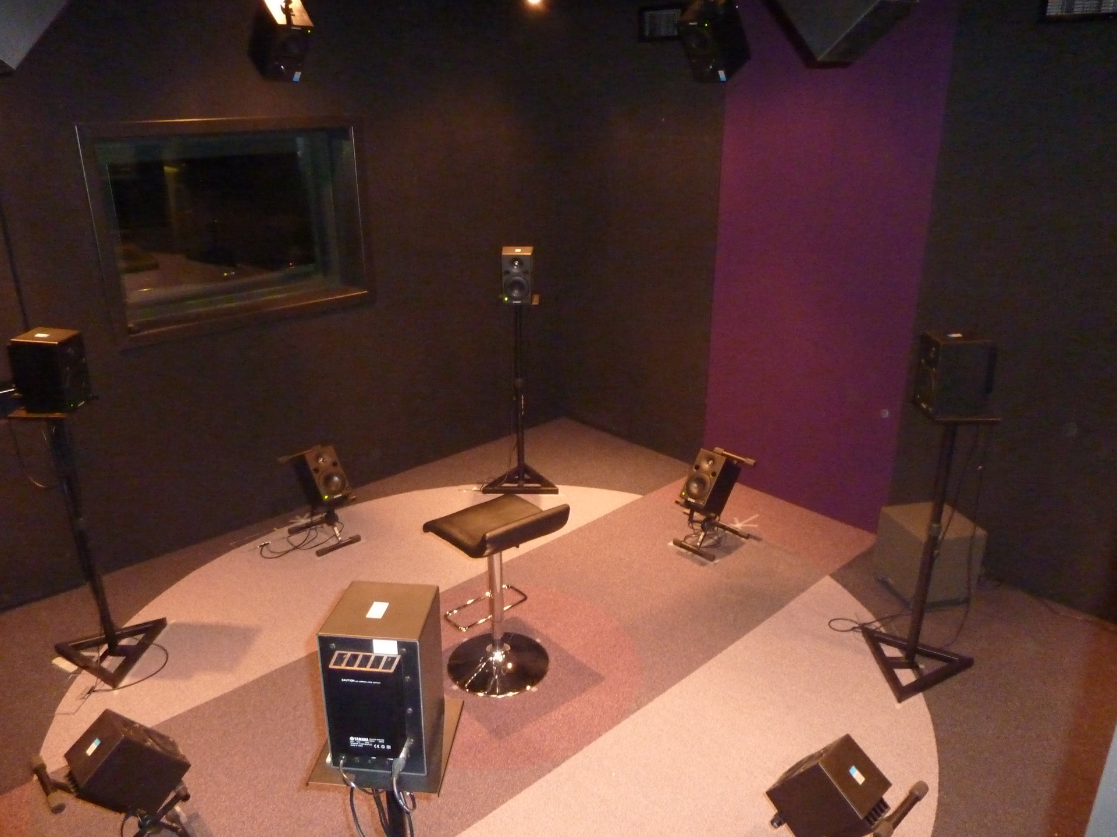
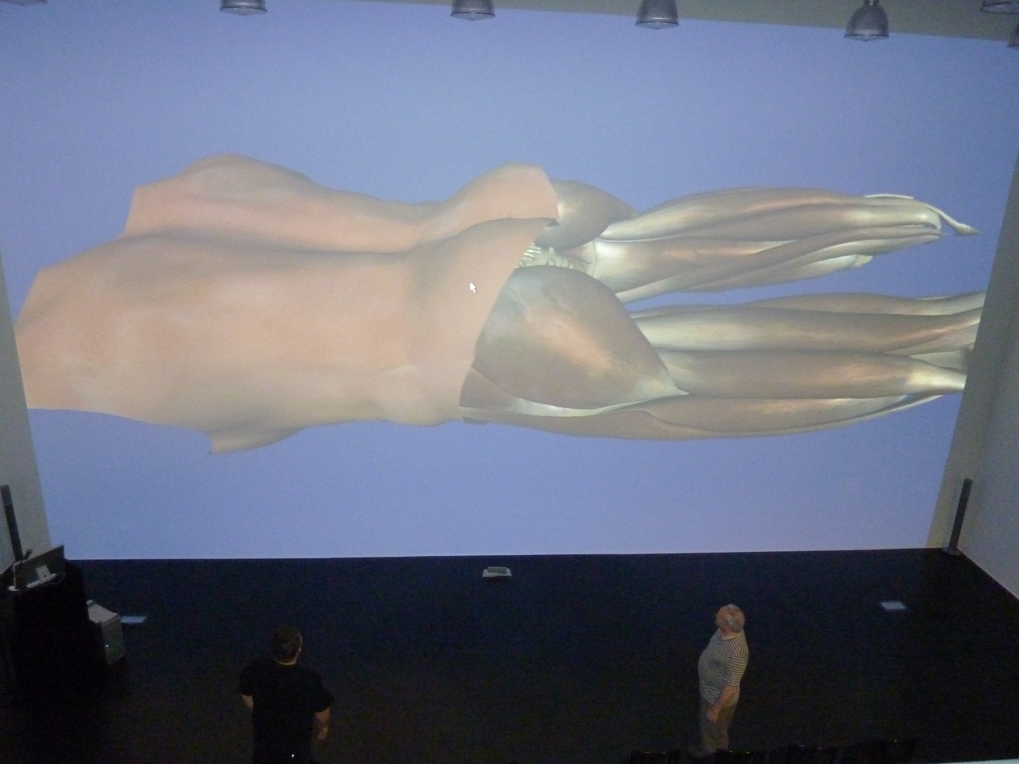


What do we do?
Ultra High Resolution Laser Scanning
3D Digital Modeling
Computer Animation
Full Body Motion Capture
Ambisonic Sound
Software/App Development
HCI: haptics, gesture recognition
Virtual Reality and virtual environments
SGs for Healthcare / education / heritage
SOUND DUB
HD EDIT SUITE
LASER SCANNING
FAKESPACE
3D SOUND LAB
MOTION CAPTURE
LAB 1
LAB 2
MEDIA TRAINING

Slide 4


Slide 6
Conversation-based vs. Game-based
Turing Test
  Conversation-based Turing Test
Imitate human communication (ie. response to interrogation)
Areas involved
  NLP
  Knowledge representation
  Information retrieval
  Reasoning
Conversations are virtually unlimited (unless topics are restricted)
Engaging with one human interrogator (1 to 1)
Single-tasking
Computer tactics:
  Artificial stupidity, e.g. deliberately introduce common typos
  Add personality

Slide 7
Game-based Turing test
Imitate human behaviours in complex gameplay, e.g. weapon choice, actions, motion (in 3D environment) and manipulation of virtual objects (e.g. weapons). More closely related to robotics than conversation-based Turing test
Areas involved
  Player modelling
  Decision making
  Path finding, motion planning (in 3D space)
  Reasoning and planning
  Voice synthesizing
  NLP
  Perception (inc. object recognition)
  Social intelligence
  Conversational behaviour

Slide 8
Game-based Turing Test
explains why game-based Turing test is currently easier to pass than conversation-based test
Less challenging: Limited by the gaming platform, e.g. actions available, will be interesting to carry out Turing test in MMORPG genre
More challenging: engaging with multiple opponents/teammates (1 to many)
Multitasking: often in chaotic combat
Computer tactics
  Artificial stupidity, e.g. emulating human irrational behaviours
“People tend to tenaciously pursue specific opponents without regard for optimality. When humans have a grudge, they’ll chase after an enemy even when it’s not in their interests. We can mimic that behaviour.”
  Add personality (player modelling)

Slide 9
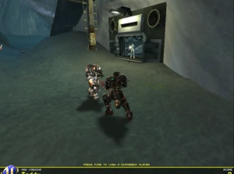
BotPrize
Participants create NPCs for UT 2004 (a FPS game) that can fool opponents (judges) into thinking it is a human player
In BotPrize 2012 two teams have passed the human-like play barrier
Computer gets a rating higher than the ratings of the real humans?

Slide 10
BotPrize 2012 results
NPCs
Human Players
bot name | humanness %
MirrorBot | 52.2 %
UT^2 | 51.9 %
ICE-CIG2012 | 36.0 %
NeuroBot | 26.1 %
GladiatorBot | 21.7 %
AmisBot | 16.0 %
average | 34.2 %
player name | humanness %
Samaneh Rastegari | 53.3 %
Craig Speelman | 52.2 %
John Weise | 30.8 %
Chris Holme | 26.3 %
average | 41.4 %
Only judgements made by human judges are counted.
Epic bots 37.8%

Slide 11
However, not all games involve humanoid character
How about game-based Turing test in board game or casual games platform?
The limitation by the platform of 3D video games is removed
Computer players are virtually unbeatable by humans in chess, poker, and many other games
  Deep Blue vs. Garry Kasparov (1997)
  Watson vs. Ken Jennings & Brad Rutter (2012)
Many fans and chess lovers plays online matches, but who are we playing with?
Has computer passed the Turing Test in these games?

Slide 12
No. The purpose of game AI is
Not to create unbeatable games
but to create indistinguishable computer players (NPCs / bots)

Slide 13
The Turing Test and Chess
Chess can revealing much more about human beings and their behavior, through the symbolism of the game and the way we play
It cannot reveal a lot about a bot if not the accuracy of the programmers & software
So the Turing Test challenge in chess platform is more on player modelling and mimic a specific type of players’ behaviour

Slide 14
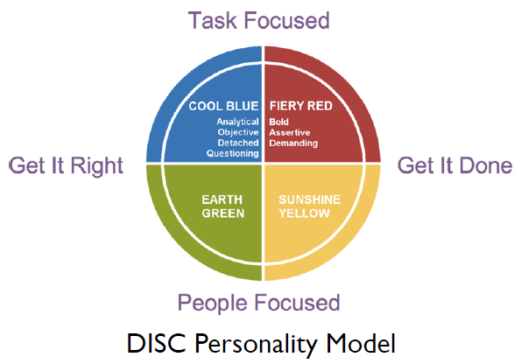
Gwaredd Mountain, Technical Director for Climax

Slide 15
Bartle player models
Richard Bartle gives a well used profiling system based on a set of game-scenario questions
Classifies players into four types
  Explorer, Achiever, Socialiser, Killer
http://www.gamerdna.com/quizzes/bartle-test-of-gamer-psychology

Slide 16
Mimic the specific player type of human judge (player)
Mimic the body language of those you are conversing with, so that you can get closer to them in a non-verbal fashion. If someone is gesturing a lot, you can join in, while if a person is more reserved, you shouldn't gesture too wildly.
Build up a model of players through player observation
  Monitor what human players are doing in the game
    See what they are doing
    Understand why they’re doing it
Mimic their player type. e.g. be a socialiser if the human player is a socialiser.

Slide 17
Game-based Turing test
Shifting of the goal
Game-defined goals
or self-defined goals
Game-based Turing test
Pursuing/ killing enemies
Level up
Advance character
Access new content
Better weapons/ outfit
Higher place on the League table
Mimic human behaviours, even act irrationally

Slide 18
Reverse Turing Test
A formal reverse Turing test follows the same format as a Turing test. Human subjects attempt to imitate the conversational style of a computer program such as ELIZA

Slide 19
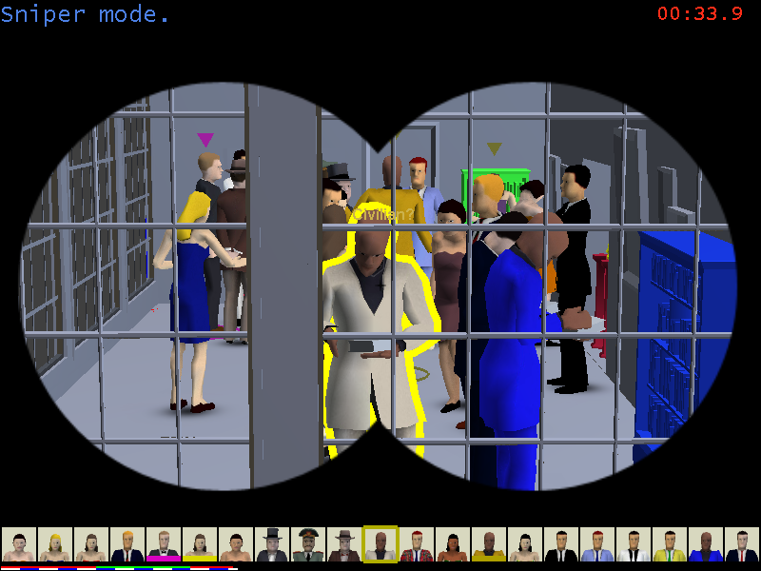
SpyParty – a reverse Turing Test in video game
NPCs imitating human behaviors
Human imitating NPCs
sniper vs. spy
  spy - avoid detection from the sniper, who has a full view of the party
  sniper - distinguish the spy and kill him

Slide 20
Summary
Conversation-based vs. game-based Turing test
Loebner Prize vs. BotPrize
Turing test in board games (chess)
Turing test in video games (UT2004)
Player modelling and mimic player types
The goal of game AI
When the goals merge, a reversed Turing test in SpyParty
Notes:
rather than from a didactic, passive role

Slide 21



Further information
www.gsa.ac.uk/dds
DDS Facebook
http://facebook.com/digitaldesignstudio
Follow us on Twitter @ddsgsa
m.ma@gsa.ac.uk

